Slide 1

Parallel Programming in C with MPI and OpenMP
Michael J. Quinn

Slide 2
Chapter 16
Combinatorial Search

Slide 3
Outline
Terminology
Divide and conquer
Backtrack search
Distributed termination detection
Branch and bound
Searching game trees

Slide 4
Terminology
Combinatorial algorithm: computation performed on discrete structure
Combinatorial search: finding one or more optimal or suboptimal solutions in a defined problem space
Kinds of combinatorial search problem
  Decision problem
  Optimization problem

Slide 5
Combinatorial Search: Examples
Laying out circuits in VLSI
Planning motion of robot arms
Assigning crews to airline flights
Proving theorems
Playing games

Slide 6
We’ll Study Four Combinatorial Search Methods
Divide and conquer
Backtrack search
Branch and bound
Alpha-beta search

Slide 7
Search Tree
Each node represents a problem or sub-problem
Root of tree: initial problem to be solved
Children of a node created by adding constraints
AND node: to find solution, must solve problems represented by all children nodes
OR node: to find solution, solve any of problems represented by children nodes

Slide 8
Search Tree (cont.)
AND tree
  Contains only AND nodes
  Divide-and-conquer algorithms
OR tree
  Contains only OR nodes
  Backtrack search and branch and bound
AND/or tree
  Contains both AND and OR nodes
  Game trees

Slide 9
Divide and Conquer
Divide-and-conquer methodology
  Partition a problem into subproblems
  Solve the subproblems
  Combine solutions to subproblems
Recursive: subproblems may be solved using the divide-and-conquer methodology
Example: quicksort

Slide 10
Centralized Multiprocessor Divide and Conquer
Unsolved subproblems kept in one stack
Processors needing work can access stack
Processors with extra work can put it on the stack
Effective workload balancing mechanism
Stack can become a bottleneck as number of processors increases

Slide 11
Multicomputer Divide and Conquer
Subproblems must be distributed among memories of individual processors
Two designs
  Original problem and final solution stored in memory of a single processor
  Both original problem and final solution distributed among memories of all processors

Slide 12
Design 1
Algorithm has three phases
Phase 1: problems divided and propagated throughout the parallel computer
Phase 2: processors compute solutions to their subproblems
Phase 3: partial results are combined
Maximum speedup limited by propagation and combining overhead

Slide 13
Design 2
Both original problem and final solution are distributed among processors’ memories
Eliminates starting up and winding down phases of first design
Allows maximum problem size to increase with number of processors
Used this approach for parallel quicksort algorithms
Challenge: keeping workloads balanced among processors

Slide 14
Backtrack Search
Uses depth-first search to consider alternative solutions to a combinatorial search problem
Recursive algorithm
Backtrack occurs when
  A node has no children (“dead end”)
  All of a node’s children have been explored

Slide 15
Example:
Crossword Puzzle Creation
Given
  Blank crossword puzzle
  Dictionary of words and phrases
Assign letters to blank spaces so that all puzzle’s horizontal and vertical “words” are from the dictionary
Halt as soon as a solution is found

Slide 16
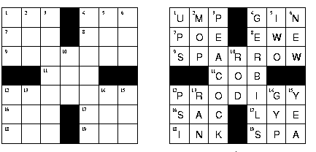
Crossword Puzzle Problem
Given a blank crossword
puzzle and a dictionary ............. find a way to fill in the
puzzle.

Slide 17
A Search Strategy
Identify longest incomplete word in puzzle (break ties arbitrarily)
Look for a word of that length
If cannot find such a word, backtrack
Otherwise, find longest incomplete word that has at least one letter assigned (break ties arbitrarily)
Look for a word of that length
If cannot find such a word, backtrack
Recurse until a solution is found or all possibilities have been attempted

Slide 18
State Space Tree
Root of tree is initial, blank puzzle.
Choices for word 1
Choices for word 2
Word 3 choices
etc.

Slide 19
Backtrack Search
?
?
?
?
?
?
?

Slide 20
Backtrack Search
T
R
?
?
O
?
?
?
?
L
L
E
Y

Slide 21
Backtrack Search
T
?
R
?
C
L
O
S
E
T
S
L
?
L
?
E
?
Y
?

Slide 22
Backtrack Search
T
?
R
?
C
L
O
S
E
T
S
L
?
L
?
E
?
Cannot find word.
Must backtrack.
Y
?

Slide 23
Backtrack Search
T
R
?
?
O
?
?
?
?
L
L
E
Cannot find word.
Must backtrack.
Y

Slide 24
Backtrack Search
T
?
R
?
C
R
O
Q
U
E
T
L
?
L
?
E
?
Y
?

Slide 25
Backtrack Search
T
T
R
R
C
R
O
Q
U
E
T
L
M
?
?
L
?
P
?
?
E
E
Y
D

Slide 26
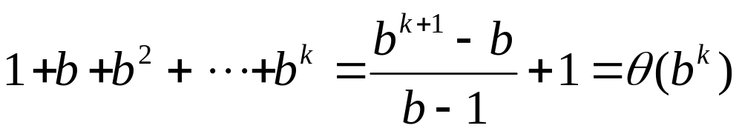
Time and Space Complexity
Suppose average branching factor in state space tree is b
Searching a tree of depth k requires examining
nodes in the worst case (exponential time)
Amount of memory required is Θ(k)

Slide 27
Parallel Backtrack Search
First strategy: give each processor a subtree
Suppose p = b^{k}
  A process searches all nodes to depth k
  It then explores only one of subtrees rooted at level k
  If d (depth of search) > 2k, time required by each process to traverse first k levels of state space tree inconsequential

Slide 28
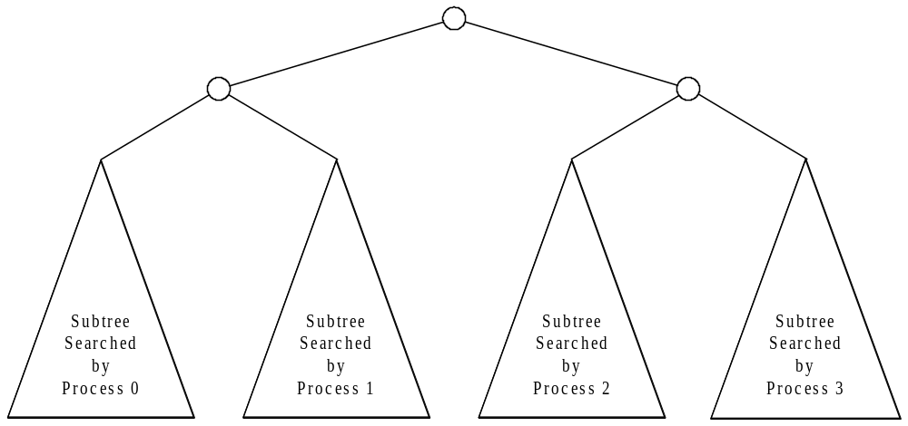
Parallel Backtrack when p = b^{k}

Slide 29
What If p ≠ b^{k} ?
A process can perform sequential search to level m of state space tree
Each process explores its share of the subtrees rooted by nodes at level m
As m increases, there are more subtrees to divide among processes, which can make workloads more balanced
Increasing m also increases number of redundant computations

Slide 30
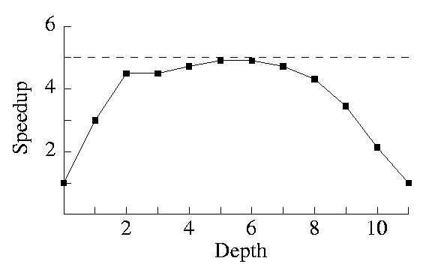
Maximum Speedup when p ≠ b^{k}
In this example 5 processors are exploring a state space
tree with branching factor 3 and depth 10.

Slide 31
Disadvantage of Allocating One Subtree per Process
In most cases state space tree is not balanced
Example: in crossword puzzle problem, some word choices lead to dead ends quicker than others
Alternative: make sequential search go deeper, so that each process handles many subtrees (cyclic allocation)

Slide 32
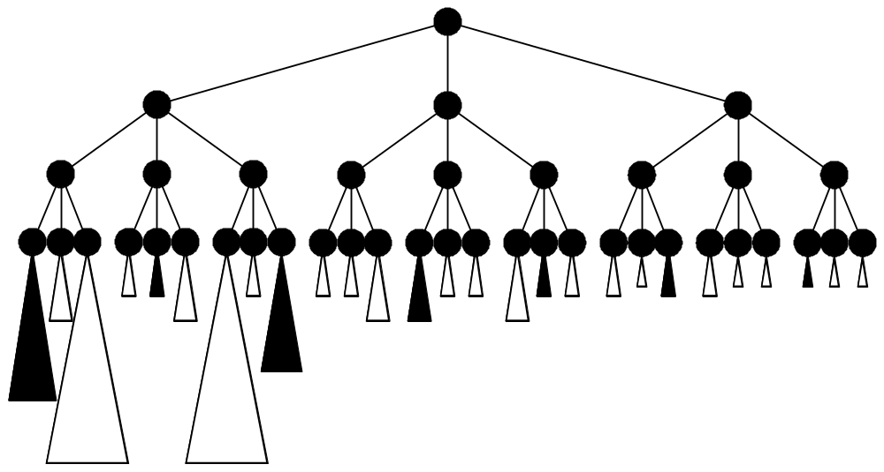
Allocating Many Subtrees per Process

Slide 33
Distributed Termination Detection
Suppose we only want to print one solution
We want all processes to halt as soon as one process finds a solution
This means processes must periodically check for messages
  Every process calls MPI_Iprobe every time search reaches a particular level (such as the cutoff depth)
  A process sends a message after it has found a solution

Slide 34
Simple (Incorrect) Algorithm
A process halts after one of the following events has happened:
  It has found a solution and sent a message to all of the other processes
  It has received a message from another process
  It has completely searched its portion of the state space tree

Slide 35
Why Algorithm Fails
If a process calls MPI_Finalize before another active process attempts to send it a message, we get a run-time error
How this could happen?
  A process finds a solution after another process has finished searching its share of the subtrees
  OR
  A process finds a solution after another process has found a solution

Slide 36
Distributed Termination Problem
Distributed termination problem: Ensuring that
  all processes are inactive AND
  no messages are en route
Solution developed by Dijkstra, Seijen, and Gasteren in early 1980s

Slide 37
Dijkstra et al.’s Algorithm
Each process has a color and a message count
  Initial color is white
  Initial message count is 0
A process that sends a message turns black and increments its message count
A process that receives a message turns black and decrements its message count
If all processes are white and sum of all their message counts are 0, there are no pending messages and we can terminate the processes

Slide 38
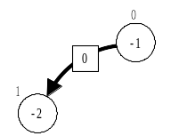
Dijkstra et al.’s Algorithm (cont.)
Organize processes into a logical ring
Process 0 passes a token around the ring
Token also has a color (initially white) and count (initially 0)

Slide 39
Dijkstra et al.’s Algorithm (cont.)
A process receives the token
  If process is black
    Process changes token color to black
    Process changes its color to white
  Process adds its message count to token’s message count
A process sends the token to its successor in the logical ring

Slide 40
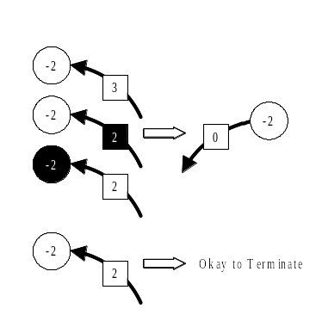
Dijkstra et al.’s Algorithm (cont.)

Slide 41
Dijkstra et al.’s Algorithm (cont.)
Process 0 receives the token
  Safe to terminate processes if
    Token is white
    Process 0 is white
    Token count + process 0 message count = 0
  Otherwise, process 0 must probe ring of processes again

Slide 42
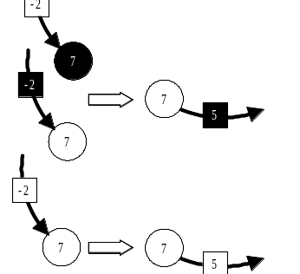
Dijkstra et al.’s Algorithm (cont.)

Slide 43
Branch and Bound
Variant of backtrack search
Takes advantage of information about optimality of partial solutions to avoid considering solutions that cannot be optimal

Slide 44
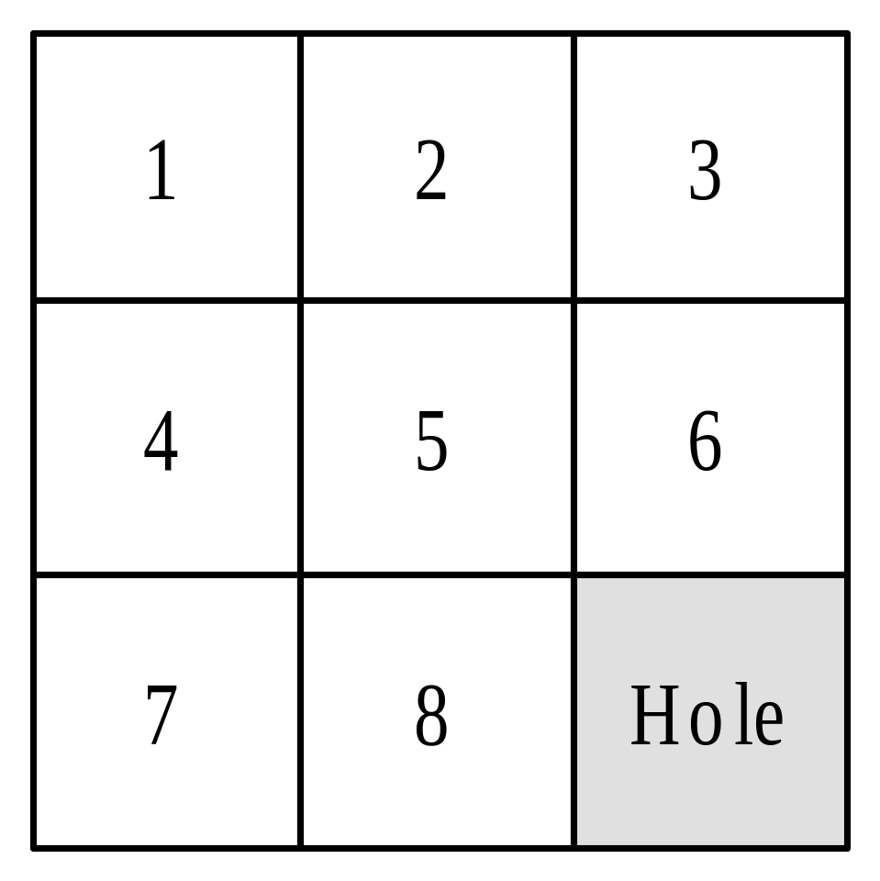
Example: 8-puzzle
This is the solution state.
Tiles slide up, down, or
sideways into hole.

Slide 45
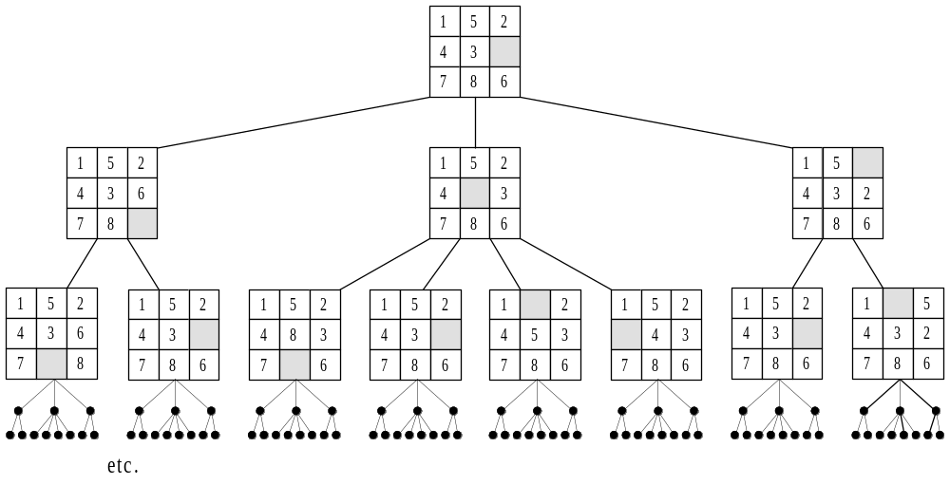
State Space Tree Represents Possible Moves

Slide 46
Branch-and-bound Methodology
Could solve puzzle by pursuing breadth-first search of state space tree
We want to examine as few nodes as possible
Can speed search if we associate with each node an estimate of minimum number of tile moves needed to solve the puzzle, given moves made so far

Slide 47
Manhattan Distance
4
3
2
3
4
3
2
1
2
3
Manhattan distance
from the yellow
intersection.
2
1
0
1
2
3
2
1
2
3
4
3
2
3
4

Slide 48
A Lower Bound Function
A lower bound on number of moves needed to solve puzzle is sum of Manhattan distance of each tile’s current position from its correct position
Depth of node in state space tree indicates number of moves made so far
Adding two values gives lower bound on number of moves needed for any solution, given moves made so far
We always search from node having smallest value of this function (best-first search)

Slide 49
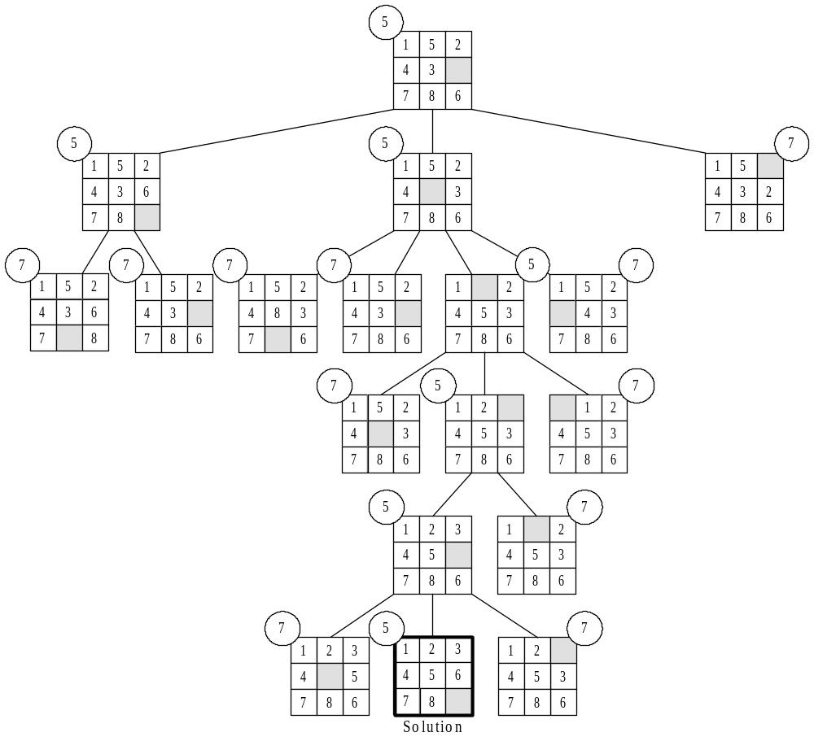
Best-first Search of 8-puzzle

Slide 50
Pseudocode: Sequential Algorithm
Intialize (q)
Insert (q, initial)
repeat
u ← Delete_Min (q)
if u is a solution then
Print_solution (u)
Halt
else
for i ← 1 to Possible_Constraints (u) do
Add constraint i to u, creating v
Insert (q, v)
endfor
endif
forever

Slide 51
Time and Space Complexity
In worst case, lower bound function causes function to perform breadth-first search
Suppose branching factor is b and optimum solution is at depth k of state space tree
Worst-case time complexity is Θ(b^{k})
On average, b nodes inserted into priority queue every time a node is deleted
Worst-case space complexity is Θ(b^{k})
Memory limitations often put an upper bound on the size of the problem that can be solved

Slide 52
Parallel Branch and Bound
We will develop a parallel algorithm suitable for implementation on a multicomputer or distributed multiprocessor
Conflicting goals
  Want to maximize ratio of local to non-local memory references
  Want to ensure processors searching worthwhile portions of state space tree

Slide 53
Single Priority Queue
Maintaining a single priority queue not a good idea
Communication overhead too great
Accessing queue is a performance bottleneck
Does not allow problem size to scale with number of processors

Slide 54
Multiple Priority Queues
Each process maintains separate priority queue of unexamined subproblems
Each process retrieves subproblem with smallest lower bound to continue search
Occasionally processes send unexamined subproblems to other processes

Slide 55
Start-up Mode
Process 0 contains original problem in its priority queue
Other processes have no work
After process 0 distributes an unexamined subproblem, 2 processes have work
A logarithmic number of distribution steps are sufficient to get all processes engaged

Slide 56
Efficiency
Conditions for solution to be found an guaranteed optimal
  At least one solution node must be found
  All nodes in state space tree with smaller lower bounds must be explored
Execution time dictated by which of these events occurs last
This depends on number of processes, shape of state space tree, communication pattern

Slide 57
Efficiency (cont.)
Sequential algorithm searches minimum number of nodes (never explores nodes with lower bounds greater than cost of optimal solution)
Parallel algorithm may examine unnecessary nodes because each process searching locally best nodes
Exchanging subproblems
  promotes distribute of subproblems with good lower bounds, reducing amount of wasted work
  increases communication overhead

Slide 58
Halting Conditions
Distributed termination detection more complicated than for backtrack search
Can only halt when
  Have found a solution
  Verified no better solutions exist

Slide 59
Modifications to DTD Algorithm
Process turns black if it manipulates an unexamined subproblem with lower bound less than cost of best solution found so far
Add additional fields to termination token
  Cost of best solution found so far
  Solution itself (i.e., moves made to reach solution)

Slide 60
Actions When Process Gets Token
Updates token’s color, count fields
If locally found solution better than one carried by token, updates token
If lower bound of first unexamined problem in priority queue ≥ best solution found so far, empties priority queue

Slide 61
Searching Game Trees
Best programs for chess, checkers based on exhaustive search
Algorithms consider series of moves and responses, evaluate desirability of resulting positions, and work their way back up search tree to determine best initial move

Slide 62
Minimax Algorithm
A form of depth-first search
Value node = value of position from point of view of player 1
Player 1 wants to maximize value of node
Player 2 want to minimize value of node

Slide 63
Illustration of Minimax
Max
1
1
0
Min
1
2
0
6
Max
1
-3
2
1
0
-5
-2
6
Min
6
-3
4
1
8
3
-2
7
1
7
2
9
0
-5
4
6

Slide 64
Complexity of Minimax
Branching factor b
Depth of search d
Examination of b^{d} leaves
Exponential time in depth of search
Hence cannot search entire tree to final positions
Must rely on evaluation function to determine value of non-final position
Space required = linear in depth of search

Slide 65
Alpha-Beta Pruning
As a rule, deeper search leads to a higher quality of play
Alpha-beta pruning allows game tree searches to go much deeper (twice as deep in best case)
Pruning occurs when it is in the interests of one of the players to allow play to reach that position

Slide 66
Illustration of Alpha-beta Pruning
Max
1
1
0
Min
1
2
0
Max
1
-3
2
0
-5
Min
6
-3
4
8
3
1
2
0
-5

Slide 67
Enhancements to Alpha-beta Pruning
Aspiration search
Iterative deepening

Slide 68
Aspiration Search
Ordinary alpha-beta algorithm begins with pruning window (–∞, ∞) (worst value, best value)
Pruning increases as window shrinks
Goal of aspiration search is to start pruning sooner
Make estimate of value v of board position
Figure probable error e of that estimate
Call alpha-beta with initial pruning window
(v–e, v+e)
If search fails, re-do with (–∞, v–e) or (v+e, ∞)

Slide 69
Iterative Deepening
Ply: level of a game tree
Iterative deepening: use a (d–1)-ply search to prepare for a d-ply search
Allows time spent in a search to be controlled: can iterate deeper and deeper until allotted time has expired
Can use results of (d–1)-ply search to help order nodes for d-ply search, improving pruning
Can use value returned from (d–1)-ply search as center of window for d-ply aspiration search

Slide 70
Parallel Alpha-beta Search
Perform move generation in parallel
  CMU’s custom chess machine HITECH
Search the tree in parallel
  IBM’s Deep Blue
  Capable of searching more than 100 millions positions per second
  Defeated Gary Kasparov in a six-game match in 1997 by a score of 3.5 - 2.5

Slide 71
Parallel Aspiration Search
Create multiple windows, one per processor
Allows narrower windows than with a single processor, increasing pruning
Chess experiments: maximum expected speedup usually not more than 5 or 6
This is because there is a lower bound on the number of nodes that will be searched, even with optimal search window

Slide 72
Parallel Subtree Evaluation
Processes examine independent subtrees in parallel
Search overhead: increase in number of nodes examined through introduction of parallelism
Communication overhead: time spent coordinating processes performing the search
Reducing one kind of overhead is usually at expense of increasing other kind of overhead

Slide 73
Game Trees Are Skewed
In a perfectly ordered game tree the best move is always the first move considered from a node
In practice, search trees are often nearly perfectly ordered
Such trees are highly skewed: the first branch takes a disproportionate share of the computation time

Slide 74
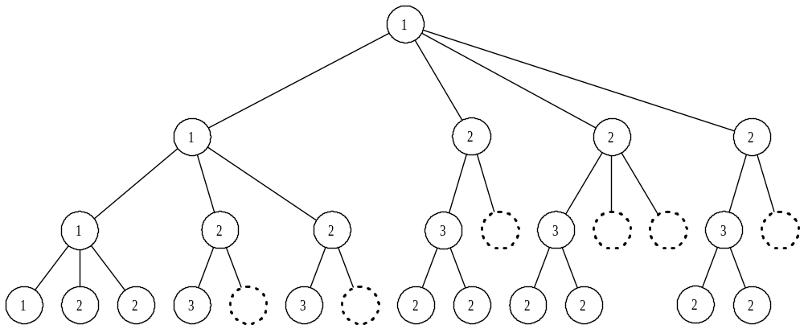
Alpha-beta Pruning of a Perfectly Ordered Game Tree

Slide 75
Distributed Tree Search
Processes control groups of processors
At beginning of algorithm, root process is assigned root node of tree and controls all processors
Allocation of processors depends on location in search tree

Slide 76
Distributed Tree Search (cont.)
Type 1 node
  All processors initially allocated to search leftmost child of node
  When search returns, processors assigned to remaining children in breadth-first manner
Type 2 or 3 node: processes assigned to children in breadth-first manner
When a process completes searching a subtree, it returns its allocated processors to its parent and terminates
Parents reallocate returned processors to children that are still active

Slide 77
Performance of Distributed Tree Search
Given a uniform game tree with branching factor b
If alpha-beta algorithm searches tree with effective branching factor b^{x}, then DTS with p processors will achieve a speedup of O(p^{x})

Slide 78
Summary (1/5)
Combinatorial search used to find solutions to a variety of discrete decision and optimization problems
Can categorize problems by type of state space tree they traverse
Divide-and-conquer algorithms traverse AND trees
Backtrack search and branch-and-bound search traverse OR trees
Minimax and alpha-beta pruning search AND/OR trees

Slide 79
Summary (2/5)
Parallel divide and conquer
  If problem starts on a single process and solution resides on a single process, then speedup limited by propagation and combining overhead
  If problem and solution distributed among processors, efficiency can be much higher, but balancing workloads can still be a challenge

Slide 80
Summary (3/5)
Backtrack search
  Depth-first search applied to state space trees
  Can be used to find a single solution or every solution
  Does not take advantage of knowledge about the problem to avoid exploring subtrees that cannot lead to a solution
  Requires space linear in depth of search (good)
  Challenge: balancing work of exploring subtrees among processors
  Need to implement distributed termination detection

Slide 81
Summary (4/5)
Branch-and-bound search
  Able to use lower bound information to avoid exploration of subtrees that cannot lead to optimal solution
  Need to avoid search overhead without introducing too much communication overhead
  Also need distributed termination detection

Slide 82
Search (5/5)
Alpha-beta pruning:
  Preferred method for searching game trees
  Only parallel search of independent subtrees seems to have enough parallelism to scale to massively parallel machines
  Distributed tree search algorithm a way to allocate processors so that both search overhead and communication overhead are kept to a reasonable level

